Slide 1
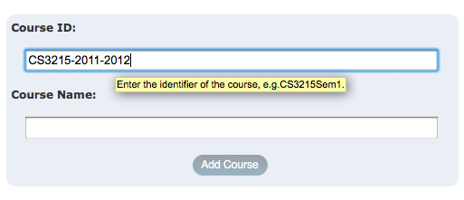
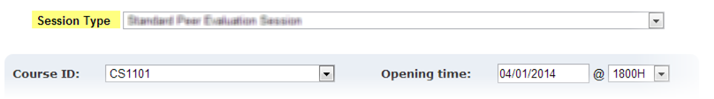

Slide 2
Self evaluation
My estimated contribution:
Equal Share + 10%
Comments about my contribution: (shown to other team members)
I was the team leader for this round, appointed by a vote.
I coordinated most of the work and did the research component on my own.
Comments about team dynamics: (Only shown to instructors)
Our team got to a slow start but things are moving smoothly now.
There is a high level of team spirit at this stage.
Evaluation for: Jean Wong
His/her estimated contribution:
Equal Share - 20%
My comments about this team member: (Only shown to instructors)
Good in meetings, but rarely delivers on time.
Probably too busy with other courses.
My feedback to this team member: (shown anonymously to the team member)
<<What I appreciate about you as a team member>> Your enthusiasm at meetings. You are very good at running a meeting and keeping things on track.
<<Areas you can improve further>>
Deliver what you promised. Your contribution between meetings can be improved.

Slide 3
Team | Student | Claimed contribution | Perceived contribution | Difference | Ratings received
Team 1 | Danny Engrid | Equal share | Equal share | 0 | Equal share Equal share
Team 1 | Emily Fowler | Equal share | Equal share | 0 | Equal share Equal share
Team 1 | Fred Garret | Equal share | Equal share | 0 | Equal share Equal share
Team 2 | Alice Betsy | Equal share + 10% | Equal share + 5% | -5% | Equal share + 6% Equal share + 4%
Team 2 | Benny Charles | Equal share | Equal share - 1% | -1% | Equal share - 2% Equal share
Team 2 | Charlie Davis | Equal share + 10% | Equal share - 4% | -14% | Equal share - 4% Equal share - 4%

Slide 4
Result for: Alice Betsy Claimed contribution: Equal share + 10% Perceived contribution: Equal share + 5%
Self-evaluation: I did my best for this project. I justified my ideas when needed and did more than the work assigned to me.
Comments about the team: Although we had some difficult times, overall the project is going so far.
From Student | Contribution estimation | Confidential comments | Peer feedback
Benny Charles | Equal share + 4% | Alice was a bit confrontational, but she is very passionate about the work. | <<What I appreciate about you as a team member>> Your passion and enthusiasm. <<Areas you can improve further>> Take it easy when others don’t agree with you :-).
Charlie Davis | Equal share + 6% | Alice always puts her heart into project work. | <<What I appreciate about you as a team member>> Thanks for putting in the extra effort Alice. <<Areas you can improve further>> Consider others ideas more. There is more than one way to do something. :-p

Slide 5
My view: | of me: Equal share + 10% | of others: Equal share -10% , Equal share
Team view: | of me: Equal share + 5% | of others: Equal share -2% , Equal share -3%
Anonymous feedback from team members | <<What I appreciate about you as a team member>> Your passion and enthusiasm. <<Areas you can improve further>> Take it easy when others don’t agree with you :-). <<What I appreciate about you as a team member>> Thanks for putting in the extra effort Alice. <<Areas you can improve further>> Consider others ideas more. There is more than one way to do something. :-p
What others said about their own contribution | Benny Charles: I think I did more than my share of the work. Charlie Davis: I did all the documentation work, even the parts assigned to others.

Slide 6
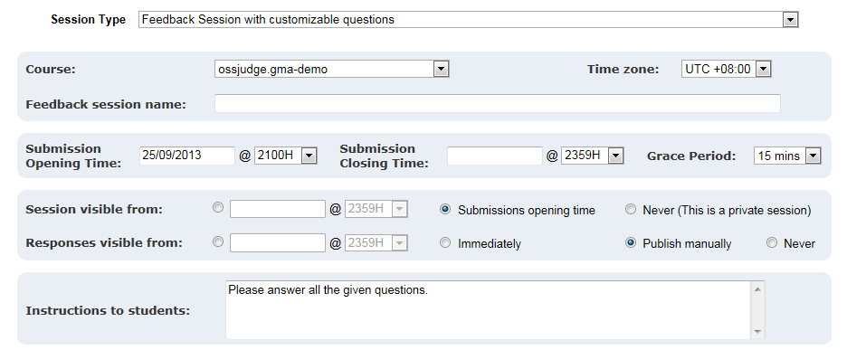
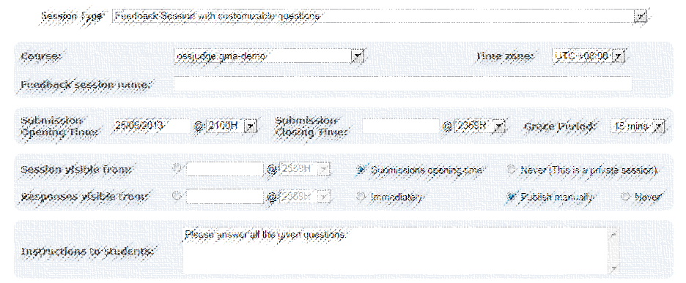

Slide 7
Question 5: Essay question
Tutor comments about the team presentation
Feedback giver:
Instructors in this course
Feedback recipient:
Teams in this course
User group | Can see answer | Can see giver’s name | Can see recipient’s name
Recipient(s)
Giver’s team members
Recipient’s team members
Other students in the course
Instructors of the course

Slide 8
Question 5: Tutor comments about the team presentation
Visibility of your responses: Other instructors in this course can see your response, the name of the recipient, and your name.
The receiving students can see your response, and your name.
For Team 1:
The content was good but overran the time limit
For Team 2:
It did not look like you did any preparations at all!
For Team 3:
Good job! It was a pleasure to watch.

Slide 9
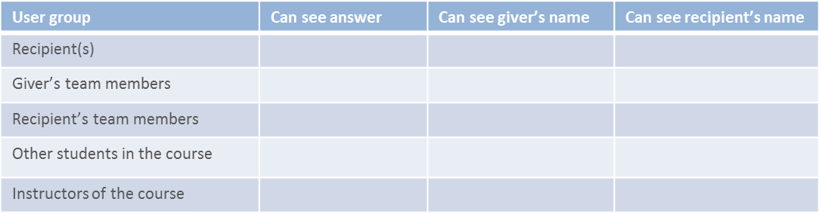
Question 6: MCQ question
Was this team member punctual?
Yes
x
No
x
+ add option
Feedback giver:
Students in this course
Feedback recipient:
Giver’s team members

Slide 10
Question 6: Whose presentation did you like the best?
Alice Betsy
Danny Engels
Benny Carmen
Emily Fowler
Charlie Davis
Frank Gore
Preview session as:
[team 2] Emily Fowler
Preview as Student
Tutor James Hamler
Preview as Instructor

Slide 11
Question 6: MCQ question
Whose presentation did you like the best?
x
Generate options from the list of :
Students
x
+ add option
Feedback giver:
Students in this course
Feedback recipient:
Giver’s team members

Slide 12
Question 1: Tutor comments about the team presentation
From: Tutor James Hardy | The content was good but overran the time limit
From: Dr Lee Davis | Good presentation. Pease keep to time limit.
Question 2: Was this team member punctual?
From: anonymous | Yes No
From: anonymous | Yes No
From: anonymous | Yes No

Slide 13
From : Tutor James Hardy
Question 1: Tutor comments about the team presentation
To: Team 1 | The content was good but overran the time limit
To: Team 2 | It did not look like you did any preparations at all!
To: Team 3 | Good job! It was a pleasure to watch.
From: Charlie Davis

Slide 14
Search
Show only courses
Show only teams
Show emails
[course1] Econ 101
[course1] team 2
abc@gmail.com
abc@gmail.com
dcr@gmail.com
ave@gmail.com
[course1] Econ 101
[course1] team 3
x
x
[course1] Econ 101
[course2] team 1
x
x
[course1] Econ 101
[course2] team 2
[course1] Econ 101
[course2] team 3
Send email

